Slide 1
The Chubby lock service for loosely-coupled distributed systems
Group No. 5
Juhi Pradeep Mehta, Ahmed Basha, Waqas Yousaf

Slide 2
Agenda
2 Min
1 Min
4 Min
2 Min
2 Min
2 Min
INTRODUCTION
ARCHITECTURE
LOCKS
SESSIONS
CACHING
CONCLUSION
What are the objectives of Chubby lock system?
How is the internal system structure? What are its major components?
What are locks? How they work? Why they are useful?
How is the communication between client and master?
How does the caching system works in Chubby lock system?
How can we use Chubby lock system in Fog Computing?

Slide 3
2 Min
1 Min
4 Min
2 Min
2 Min
2 Min
INTRODUCTION
ARCHITECTURE
LOCKS
SESSIONS
CACHING
CONCLUSION
What are the objectives of Chubby lock system?
How is the internal system structure? What are its major components?
What are locks? How they work? Why they are useful?
How is the communication between client and master?
How does the caching system works in Chubby lock system?
How can we use Chubby lock system in Fog Computing?

Slide 4
Introduction
Lock service for loosely coupled distributed systems.
Read and writes Small files.
Provide coarse-grained locking instead of fine-grained.
Used in Google such as GFS and Bigtable.
Primary goals:
Reliability, availability to large set of clients.
Easy for developers to add locking semantics.
Secondary goals:
Throughput.
Storage capacity.

Slide 5
2Min
1 Min
4 Min
2 Min
2 Min
2 Min
INTRODUCTION
ARCHITECTURE
LOCKS
SESSIONS
CACHING
CONCLUSION
What are the objectives of Chubby lock system?
How is the internal system structure? What are its major components?
What are locks? How they work? Why they are useful?
How is the communication between client and master?
How does the caching system works in Chubby lock system?
How can we use Chubby lock system in Fog Computing?

Slide 6
Architecture
If a replica fails and does not recover
A fresh machine is selected to be a new replica, replacing the failed one.
It updates the DNS, replace IP with the failed replica
Obtains a recent copy of the database
The current master pools DNS periodically to discover new replicas
The master commit when the new replica process
New replica is permitted to vote for new master
Note: Client application may only communicate with Master.
R
client
application
Chubby library
RPCs
M
RPCs
R
client
application
Chubby library
R
client processes
R
5 servers of chubby cell

Slide 7
2 Min
1 Min
4 Min
2 Min
2 Min
2 Min
INTRODUCTION
ARCHITECTURE
LOCKS
SESSIONS
CACHING
CONCLUSION
What are the objectives of Chubby lock system?
How is the internal system structure? What are its major components?
What are locks? How they work? Why they are useful?
How is the communication between client and master?
How does the caching system works in Chubby lock system?
How can we use Chubby lock system in Fog Computing?

Slide 8

Locks
Replica
Replica
Master
Replica
Replica
File
Chubby cell
Lock lease is expired, lock is removed
1
4
Request lock
Give read/write permission
Give read/write permission
Request lock
2
3
Wait!
Client
Application
Client
Application

Slide 9
2 Min
1 Min
4 Min
2 Min
2 Min
2 Min
INTRODUCTION
ARCHITECTURE
LOCKS
SESSIONS
CACHING
CONCLUSION
What are the objectives of Chubby lock system?
How is the internal system structure? What are its major components?
What are locks? How they work? Why they are useful?
How is the communication between client and master?
How does the caching system works in Chubby lock system?
How can we use Chubby lock system in Fog Computing?

Slide 10
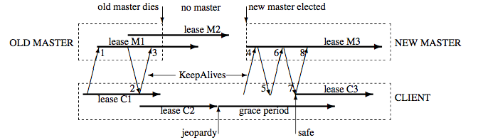
Sessions
Relationship between Chubby cell and Chubby client
Client sends Periodic message to master to keep by session up.
Messages are named as KeepAlive.
The master will block KeepAlive until close the expiration of a session. Extension is default to 12s.
Image source: [1]

Slide 11
2 Min
1 Min
4 Min
2 Min
2Min
2Min
INTRODUCTION
ARCHITECTURE
LOCKS
SESSIONS
CACHING
CONCLUSION
What are the objectives of Chubby lock system?
How is the internal system structure? What are its major components?
What are locks? How they work? Why they are useful?
How is the communication between client and master?
How does the caching system works in Chubby lock system?
How can we use Chubby lock system in Fog Computing?

Slide 12
Caching
File Updated
Replica
Replica
Master
Replica
Replica
File
Chubby Cell
Cached File
Local Cache
Client
Application
Client
Application
Client
Application
Client
Application
time

Slide 13
2 Min
1 Min
4 Min
2 Min
2 Min
2 Min
INTRODUCTION
ARCHITECTURE
LOCKS
SESSIONS
CACHING
CONCLUSION
What are the objectives of Chubby lock system?
How is the internal system structure? What are its major components?
What are locks? How they work? Why they are useful?
How is the communication between client and master?
How does the caching system works in Chubby lock system?
How can we use Chubby lock system in Fog Computing?

Slide 14
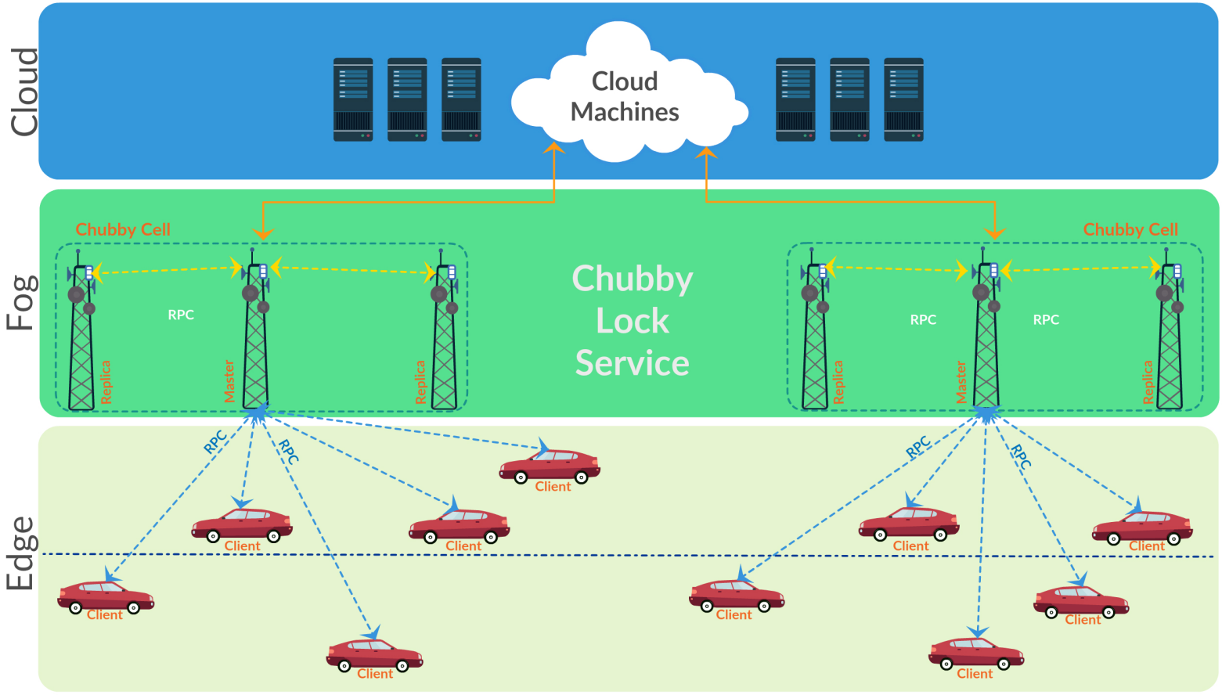
Conclusion
Where and how would you deploy Chubby lock service?

Slide 15
Conclusion
Chubby is more applicable where availability and reliability is much important than performance/throughput.
In Internet of Things field, most of applications need high availability of services and strong reliability/consistency of data.
Does it make sense to use systems such as “Chubby Lock Service” in Fog Computing?

Slide 16
Conclusion
Horizontal scaling of master node in a cluster.
Failover problem: avoiding the overload of read only session, the newly created read only sessions might not be stored on the database after interruption and starts as new.
Abusive Clients: fix to such a performance issue is to perform aggressive caching of frequently used resources so that there is a significant load reduction on the server side.
Would you recommend to make any changes or adjustments?

Slide 17
References
[1]. Mike Burrows, G. I. (n.d.). The Chubby lock service for loosely-coupled distributed systems.
[2]. Bayraktar, A. U. (2016). Internet Scale Distributed Systems Seminar . Retrieved from https://www.youtube.com/watch?v=zokwJeukDrI&t=267s.
[3]. Fournier, C. (2014, Nov). Chubby lock service.
[4]. Romain Jacotin, S. A. (2014, Oct). Google Chubby lock service for loosely-coupled distributed systems.
[5]. Video tutorial for Internet Scale Distributed Systems Seminar by Ali Ugur Aker and Eralp Bayraktar: https://www.youtube.com/watch?v=zokwJeukDrI

